Slide 1
Spring IoC, DI. Bean. Spring configuration.

Slide 2
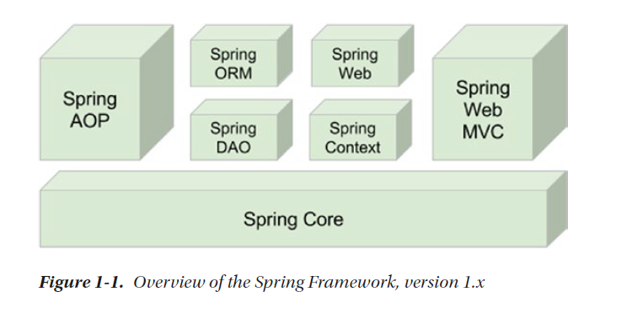
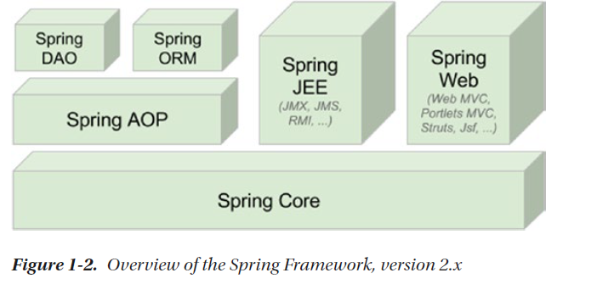
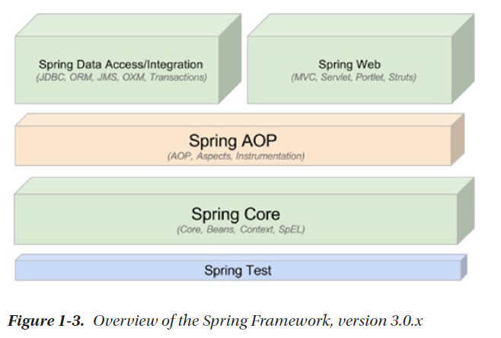
Spring

Slide 3
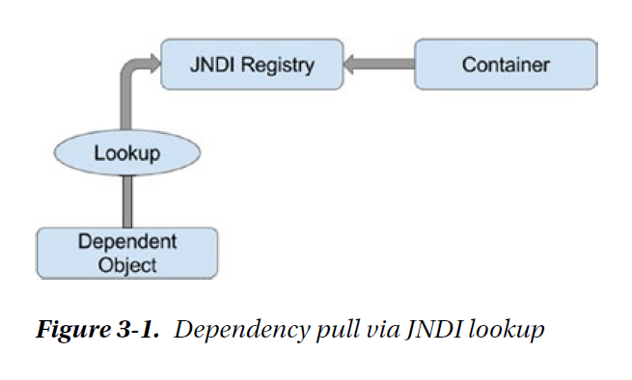
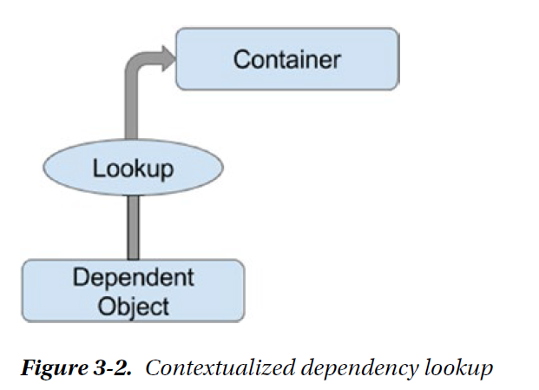
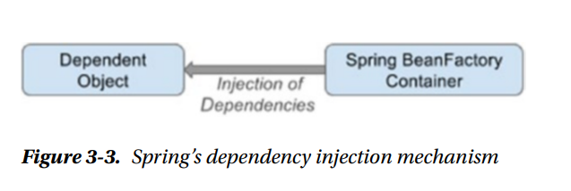
Inversion of Control. Dependency Injection
Извлечение зависимостей через поиск в реестре JNDI
Контекстный поиск зависимостей

Slide 4
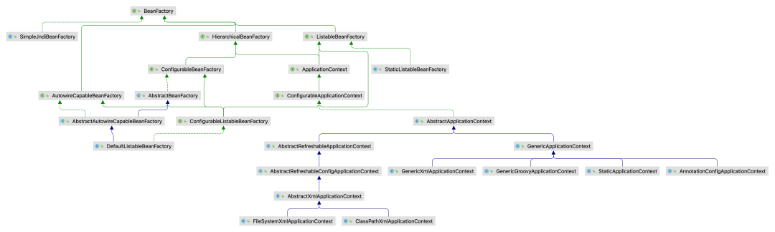

Slide 5
Inversion of Control. Dependency Injection
public class ConstructorInjection { private Dependency dependency; public ConstructorInjection(Dependency dependency) { this.dependency = dependency; } @Override public String toString() { return dependency.toString(); } }
public class SetterInjection { private Dependency dependency; public void setDependency(Dependency dependency) { this.dependency = dependency; } @Override public String toString() { return dependency.toString(); } }
public class ConstructorInjection { private Dependency dependency;
@Autowired public ConstructorInjection(Dependency dependency) { this.dependency = dependency; } @Override public String toString() { return dependency.toString(); } }
public class SetterInjection { private Dependency dependency;
@Autowired public void setDependency(Dependency dependency) { this.dependency = dependency; } @Override public String toString() { return dependency.toString(); } }

Slide 6
Inversion of Control. Dependency Injection
@Bean
public class Dependency { }
@Service
public class Dependency { }
@Component
public class Dependency { }
@Controller
public class Dependency { }
@Repository
public class Dependency { }
@RestController
public class Dependency { }

Slide 7
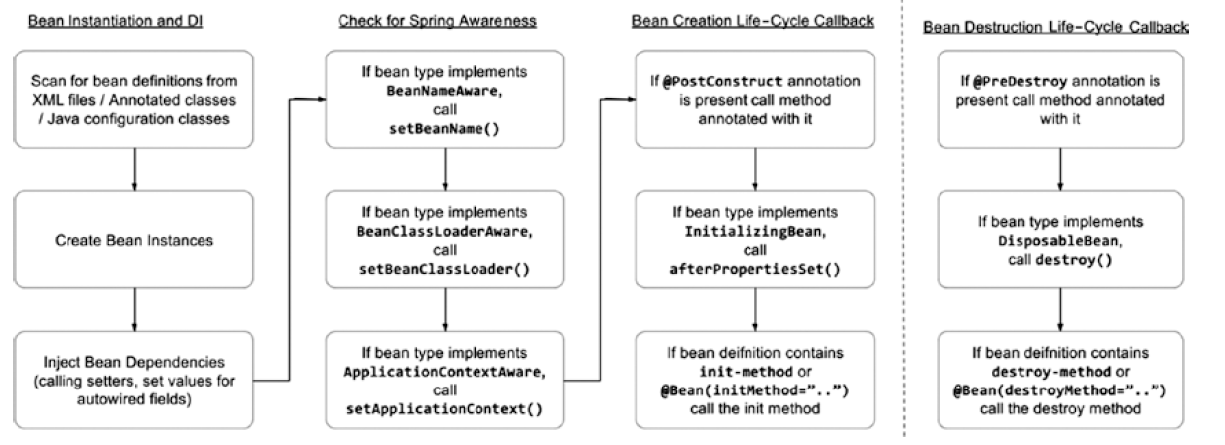
Spring Configuration.Beans

Slide 8
Spring Configuration.Beans
public class SingerConfigDemo { @Configuration static class SingerConfig{ @Lazy @Bean(initMethod = "init") Singer singerOne() { Singer singerOne = new Singer(); singerOne.setName("John Mayer"); singerOne.setAge(39); return singerOne; } @Lazy @Bean(initMethod = "init") Singer singerTwo() { Singer singerTwo = new Singer(); singerTwo.setAge(72); return singerTwo; }
public static void main(String... args) { GenericApplicationContext ctx = new AnnotationConfigApplicationContext(SingerConfig.class); getBean("singerOne", ctx); getBean("singerTwo", ctx); ctx.close(); }
public class Singer { private void init() { System.out.println("Initializing bean"); }

Slide 9
Spring Configuration.Beans
@Configuration
@EnableAutoConfiguration
@ComponentScan public class CatalogApplication { public static void main(String... args) { SpringApplication.run(CatalogApplication.class, args); } }
public class AliasConfigDemo { @Configuration static class AliasBeanConfig { @Bean(name = {"johnMayer", "john", "jonathan", "johnny"}) public Singer singer() { return new Singer(); } } public static void main(String... args) { GenericApplicationContext ctx = new AnnotationConfigApplicationContext(AliasBeanConfig.class); Map<String, Singer> beans = ctx.getBeansOfType(Singer.class); beans.entrySet().stream().forEach(b -> System.out.println( "id: " + b.getKey() + "\n aliases: " + Arrays.toString(ctx.getAliases(b.getKey())) + "\n") ); ctx.close(); } }
@SpringBootApplication public class CatalogApplication { public static void main(String... args) { SpringApplication.run(CatalogApplication.class, args); } }

Slide 10
Spring Configuration.Beans
@Configuration @EnableTransactionManagement public class PostgreDbConfig { @Value("${postgresql.db.driver}") private String dbDriver; @Value("${postgresql.db.password}") private String dbPassword; @Value("${postgresql.db.url}") private String dbUrl; @Value("${postgresql.db.username}") private String dbUsername; @Value("${postgresql.hibernate.dialect}") private String hibernateDialect; @Value("${postgresql.entitymanager.packagesToScan}") private String entitymanagerPackagesToScan; @Bean(name = "DataSource") @Primary public DataSource dataSource() { DriverManagerDataSource dataSource = new DriverManagerDataSource(); dataSource.setDriverClassName(dbDriver); dataSource.setUrl(dbUrl); dataSource.setUsername(dbUsername); dataSource.setPassword(dbPassword); return dataSource; } @Bean(name = "entityManagerFactory") @Primary public LocalSessionFactoryBean sessionFactory() { LocalSessionFactoryBean sessionFactoryBean = new LocalSessionFactoryBean(); sessionFactoryBean.setDataSource(dataSource()); sessionFactoryBean.setPackagesToScan(entitymanagerPackagesToScan); Properties hibernateProperties = new Properties(); hibernateProperties.put("hibernate.dialect", hibernateDialect); sessionFactoryBean.setHibernateProperties(hibernateProperties); return sessionFactoryBean; } @Bean(name = "postgresqlTransactionManager") @Primary public HibernateTransactionManager transactionManager() { HibernateTransactionManager transactionManager = new HibernateTransactionManager(); transactionManager.setSessionFactory(sessionFactory().getObject()); return transactionManager; } }

